Slide 1
Applications of Terahertz technology for coating measurement on composite materials Joe Buckley, Level X NDT for Baugh & Weedon / Alban NDE Irl N. Duling, Terametrix
Notes:
Hello I'm Joe Buckley I'd like to talk to you about use of terahertz technology for measurement of coating and layer thickness
Baugh and weedon are responsible for worldwide NDT market promotion of the Terametrix equipment which is manufactured in Ann Arbor, MI

Slide 2
In this talk:
An overview of Terahertz technology and Equipment
General Applications of Terahertz NDE for Composites
Case Study, coatings on Carbon fibre.

Slide 3
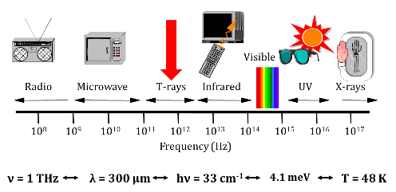
What are TeraHertz (THz)?
TeraHertz (10¹² Hz) radiation is part of the electromagnetic spectrum lying between microwaves and the far-IR.
This region was known as the “TeraHertz Gap” and relates frequencies ranging from 0.1-10THz and wavelengths from 3mm to 30μm.
Notes:
Terahertz )Million MegaHertz) radiation is in the part of the electromagnetic spectrum which lies between microwaves and the far infrared, this region has historically been difficult to investigate because the frequencies are too high for electronic methods and wavelengths too long for optical methods, It's Therefore been known as the ‘TeraHertz gap’
It involves frequencies ranging from approximately 100 GHz up to 10 TeraHertz which corresponds to wavelengths in free space from 3mm down to about 30 microns.
For NDT we are normally talking about frequencies around 100 GHz up to one or two TeraHertz, and this represents wavelengths comparable to those we are used to dealing with for ultrasound, giving us inspection resolutions that are useful for real world problems

Slide 4
What are TeraHertz (THz)?
Generally, this frequency is too high for electronics, currently highest frequency for practical electronic approaches is around 100 GHz (N.B. 5G data spectrum is up to 56 GHz).
Optical approaches fail below approx. 10THz because (among other reasons) photon energy drops into the ambient thermal range.
Recent advances in combining optical and electronic methods have allowed for the generation and detection of very high signal-to –noise ratio and high data acquisition rates of 0.1 –3.0 THz frequencies.
Consequently a surge of interest in and investigation of the terahertz region is underway.
Notes:
Terahertz radiation is in the part of the electromagnetic spectrum which lies between microwaves and the far infrared, this region has historically been difficult to investigate because the frequencies are too high for electronic methods and wavelengths too long for optical methods, It's Therefore been known as the ‘TeraHertz gap’
It involves frequencies ranging from approximately 100 GHz up to 10 TeraHertz which corresponds to wavelengths in free space from 3mm down to about 30 microns.
For NDT we are normally talking about frequencies around 100 GHz up to one or two TeraHertz, and this represents wavelengths comparable to those we are used to dealing with for ultrasound, giving us inspection resolutions that are useful for real world problems

Slide 5
Applications of TeraHertz: Imaging Through Material
Similar to X-Ray images, TeraHertz wavelengths penetrate through most non-conductive materials and can easily reveal imperfections such as voids, cracks and density variations.
Key advantage is that TeraHertz radiation is nonionizing, completely safe. Human body emits stronger THz radiation than normally used for NDT
Examples of imaging applications include:
Flaw detection of low density materials, such as“sprayed-on-foam-insulation” (SOFI) for the space program.
Detection of “threat objects” in checked airline baggage
Measurement of complex Multi-layer coatings, especially where other techniques are ineffective
Notes:
THz radiation penetrates through most non conductive materials and can reveal imperfections such as voids, cracks, and variations in density.
A key advantage is that TeraHertz radiation is non-ionizing and involves no safety issues.
Some examples of terahertz imaging applications include flaw detection of sprayed on foam insulation in applications such as the space programme
, Detection of threat objects in airline baggage - we're all familiar now with terahertz scanners that we walk through,
and measurement of complex multilayer coatings.
This is especially where other techniques such as ultrasound are ineffective due to the nature of these coatings which may for example not transmit ultrasound very well.

Slide 6
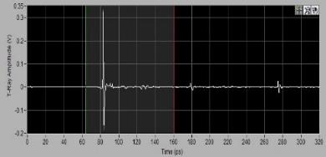
So how do we generate and detect THz radiation?
A short pulse of THz energy is produced when an ultra-short laser pulse hits a specialized photoconductive device linked to an antenna. A similar device can be used to pass current when irradiated with TeraHertz energy.
By varying the time delay between the ‘transmit’ and ‘receive’ laser pulses an ‘A-scan’ signal, similar in concept to that for ultrasound, can be displayed.
Notes:
How do we generate the terahertz radiation?
We can put an electrical bias across a very specialised photoconductive antenna and when we hit this with a very short laser light pulse it will conduct giving a short radiation burst.
This transmitter can be packaged like a standard telecom component to make the equipment reliable and robust which of course is important in practical NDT applications.

Slide 7
A typical THz Photoconductive Emitter
lithographically deposited
metal leads
semiconducting
substrate
+
-
5-10 mm
50 mm
Notes:
Hit it with a laser beam, it conducts, emits a burst of Thz energy.

Slide 8
Generation of free-space THz pulses
Generation of free-space THz pulses using ultrashort pulses on photoconductive switches
A fs pulse induces conductivity in a biased photoconductive switch.
photoconductive switch
femtosecond optical beam
radiated THz wave
DC bias
When the pulse is on, current flows. Accelerating charges emit light.

Slide 9
Measuring THz pulses using photoconductive sampling
Detecting or measuring THz usually uses the same fs optical pulse that generates it.
The fs optical pulse induces conductivity in a photoconductive switch, which then yields more current when the THz pulse is present.
photoconductive antenna
femtosecond optical beam
A
incoming THz wave
ammeter
This yields a cross-correlation between the fs optical pulse and the THz pulse.

Slide 10
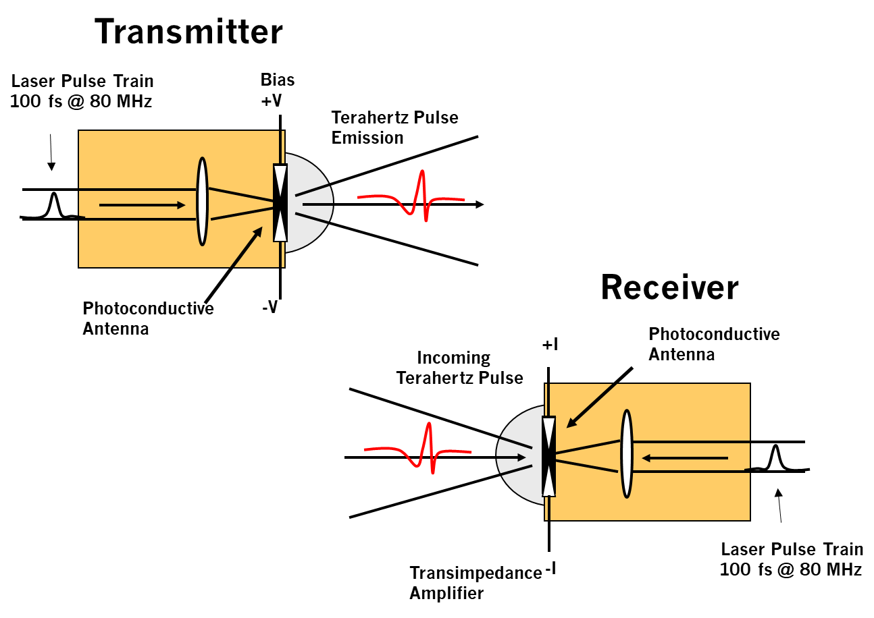
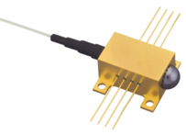
THz Generation / Detection
The transmitter can be packaged like a telecom component to provide reliability and robustness.
THz
In / Out
25 mm

Slide 11
photoconductive antenna
femtosecond optical beam
A
incoming THz wave
Scanning the delay is performed as in cross-correlation.
Antenna impedance vs. time
antenna impedance
train of THz pulses
femtosecond
laser pulse
train of fsec optical pulses
time
Because the fs optical pulse is shorter than the THz pulse, this works.

Slide 12
Typical TD-THz System
100fs Laser
Dispersion Compensation
Fiber splitter
variable delay
splitter
splitter
power meter
power meter

Slide 13
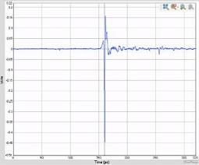
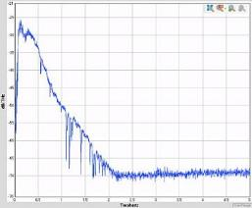
Pulse Spectrum Fast Fourier Transform (FFT)
A short pulse consists of a broad range of frequencies.
N.B. Sharp absorption lines are from the water vapor in the air.
Can apply digital filtering techniques to the received signal to select frequency range measured
Can also do spectroscopic measurements
Notes:
This shows a typical spectrum from a single laser pulse: we can see there is energy extending up to around two terahertz.
N.B. we will also see absorption lines on the Fourier transform these correspond to water vapour in the air

Slide 14
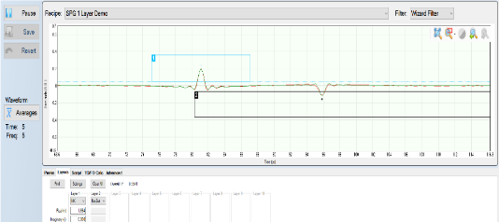
Interaction of TeraHertz waves with materials
When TeraHertz waves pass through an interface between materials having a different dielectric constant some of the energy is reflected.
We can measure the strength and timing of these reflections.
Note also phase air-plastic positive, plastic to air negative. See opposite effect with coatings later
1
2
Notes:
When terahertz waves pass through an interface between materials having different dielectric constants some of the energy is reflected.
We can measure the strength and timing of these reflections and we can then calculate the thickness of the material layers and assess whether or not they are intimately bonded, we can thus detect voids and layer separations.
You see here a typical A-scan presentation from the TeraMetrix equipment. You see a reflection in one phase at the top of the material and a reflection in the opposite phase at the lower side of the material. This is very similar (but not identical) to the presentation we would expect with ultrasound.

Slide 15
Interaction of TeraHertz waves with materials
We can then calculate the thickness of material layers and assess whether they are intimately bonded.
Waveforms resemble ultrasonic A-scans.
Wavelengths similar, just velocity around 50,000 x greater.
Timings in ps rather than us
Can use B and C-scan imaging
Voids and delaminations can be detected.
Can often visualise fibre/strand structure
TeraHertz energy will pass though air gaps and low-density materials such as foams which inhibit easy inspection with ultrasound.
Notes:
When terahertz waves pass through an interface between materials having different dielectric constants some of the energy is reflected.
We can measure the strength and timing of these reflections and we can then calculate the thickness of the material layers and assess whether or not they are intimately bonded, we can thus detect voids and layer separations.
You see here a typical A-scan presentation from the TeraMetrix equipment. You see a reflection in one phase at the top of the material and a reflection in the opposite phase at the lower side of the material. This is very similar (but not identical) to the presentation we would expect with ultrasound.

Slide 16
Applications of TeraHertz Imaging Through Material
Similar to X-Ray images, TeraHertz wavelengths penetrate through most non-conductive materials and can reveal imperfections such as voids, cracks and density variations.
Key advantage is that TeraHertz radiation is nonionizing, completely safe. Human body emits stronger THz radiation than is normally used for NDT
Examples of imaging applications include:
Flaw detection of “sprayed-on-foam-insulation” (SOFI) for the space shuttle program.
Detection of “threat objects” in checked airline baggage
Measurement of complex Multi-layer coatings, especially where other techniques are ineffective
Notes:
THz radiation penetrates through most non conductive materials and can reveal imperfections such as voids, cracks, and variations in density.
A key advantage is that TeraHertz radiation is non-ionizing and involves no safety issues.
Some examples of terahertz imaging applications include flaw detection of sprayed on foam insulation in applications such as the space programme
, Detection of threat objects in airline baggage - we're all familiar now with terahertz scanners that we walk through,
and measurement of complex multilayer coatings.
This is especially where other techniques such as ultrasound are ineffective due to the nature of these coatings which may for example not transmit ultrasound very well.

Slide 17
A Note on Equipment
This is not intended to be a sales presentation, but it is presented in the context of the Terametrix equipment with which I am familiar.
Other brands are available, and some operate differently.
There are some operational analogies with ultrasound equipment, but these should not be over stretched!
A few brief words of explanation about the equipment used are in order.

Slide 18
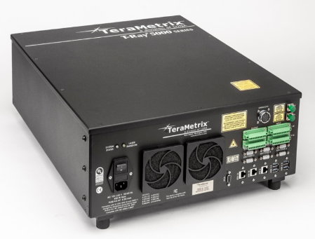
Equipment: Terahertz Control Unit
The Terametrix systems consist of a Terahertz Control Unit (TCU), which is available in various options, the key differences are:
Scan range / PRF options (determined by the variable delay line):
700ps or 320ps at 100Hz
160ps or 80ps at 1kHz
Single or Dual channel

Slide 19
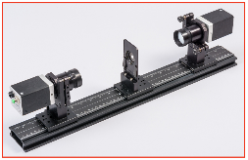
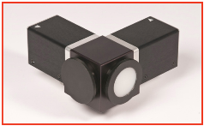
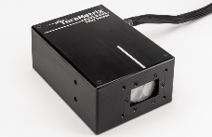
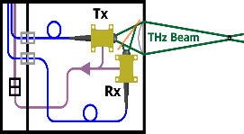
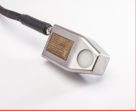
Sensor Heads
Connected to TCU via fibre optic & electrical umbilical cables up to 30m
Can be configured as single sided or through-transmission
1
2
3
Transmitter and receiver on spectroscopy rail
Transmitter and receiver on colinear adapter
Transmitter/receiver in industrial housing
Explosion proof TR sensor. (For paint monitoring)
4
Notes:
Focussing is critical.

Slide 20
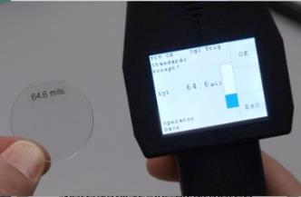
Handheld sensors - Single point Gauge
Transmit receive sensor.
Pistol grip with trigger
Display, showing multiple values (normally layers)

Slide 21
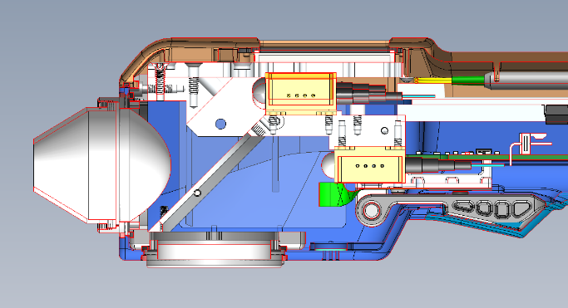
Handheld sensors - Single point Gauge
Cross section showing sensors and lens.
Lens
Beam Splitter

Slide 22
Handheld sensors – Line Scan gauge
Opto-mechanical scanning system
8 scans per second maximum
B-scan imaging
Colour display and laser positioning guide.

Slide 23
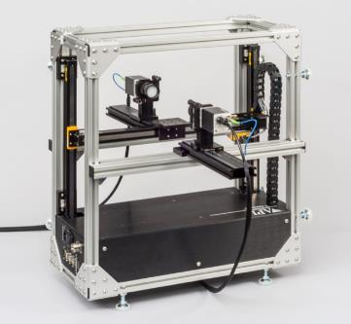
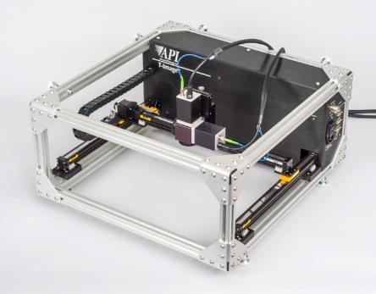
Scanners – T-image system
Transmission or reflection
Portable
30 x 30 cm area
Numerous custom scanning systems possible

Slide 24
Back to the Technical bit
That’s more than enough !
(If you want to buy one talk to me or Flynn later!)

Slide 25
Applications of TeraHertz
Industrial Process Control
Thickness
Area Density (e.g. thin films, paper)
Delamination
Aerospace/NDT Quality Control
Coating thickness
Defect location
Research
Spectroscopy
Imaging
Cultural Heritage
Notes:
There are many applications of terahertz radiation and more being developed.
In industrial process control it's used to measure the thickness of non-conductive materials.
It can be used to correlate the strength of reflection to area density, for example in measuring the weight of paper.
It can be used to detect delaminations between layers.
In aerospace ndt it's being used to measure coating thickness and locate defects in high technology materials.
There are also many research applications of terahertz radiation such as spectroscopy (which we'll talk about a bit more later), various types of imaging, and it's also been used in a number of cultural heritage applications for example measuring multiple layers on paintings

Slide 26
Key limitations of Terahertz
Only works though non-conductive materials (skin effect)
Even carbon fibre is too conductive to see past the front couple of plies.
But excellent for measuring non-conductive coatings on CFK
Limited Thickness
Time scan for Received signal is generated using a combination of an adjustable optical delay and a rotating mirror, so the A-scan length is limited.
With 1kHz PRF / 160 ps scan Unit, maximum reflection range is around 17 or so mm in typical plastics, so allowing for some position error, if we need to also see the front face the maximum practical thickness is around 13mm
Slower 100Hz/700ps PRF configuration can test to ≈ 70mm
Notes:
There are some key limitations with a terahertz system: one of the obvious ones is they can only work on non conductive materials even carbon fibre is too conductive to see past the first couple of plies.
The other important limitation of terahertz measurements is limited thickness:
because we generate the time delay for the received signal using a combination of an adjustable optical delay and a rotating mirror the A-scan length is limited.
Typically with the 1 kHz PRF / 160 picoseconds unit the maximum reflection range is around 17 millimetres in a typical plastic, so allowing for some position error if we need to measure the front face and the rear space the maximum practical thickness is around 13mm
We can of course shift the zero point as long as not seeing the front face is okay but this would require very stable physical positioning to make any measurements.
The 100 Hertz PRF unit can be specified with up to 700 picoseconds A-scan length this corresponds to around 75 millimetres in plastic.

Slide 27
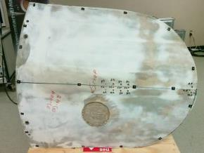
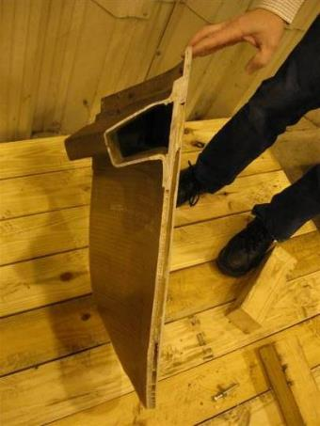
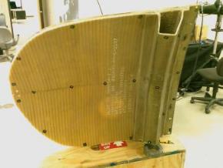
Composite Fibre NDT (1)
C-130 Radome Section

Slide 28
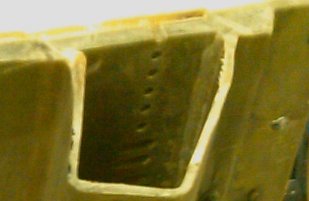
Composite Fibre NDT (1)
C-130 Radome Section
Examination of Support Bracket
Detail of Scanned Area
Scan Cross Section showing 3 layers

Slide 29
Composite Fibre NDT (1)
C-130 Radome Section
bw-nde.com
Examination of Support Bracket (2)
Reflection from first surface is isolated as a
region of interest (ROI) with cursors, an image
is formed using the integrated power between
the cursors.

Slide 30
Composite Fibre NDT (1)
C-130 Radome Section
bw-nde.com
Examination of Support Bracket (3)
The ROI is moved to the second surface, and an
image is formed using the integrated power
between the cursors.
The ribbed channel structure can be identified.

Slide 31
Composite Fibre NDT (1)
C-130 Radome Section
bw-nde.com
Examination of Support Bracket (4)
The ROI is moved to the third surface, and an
image is formed using the integrated power
between the cursors. Now the drilled holes can
be seen.
All three images were made from the data of a
single scan.

Slide 32
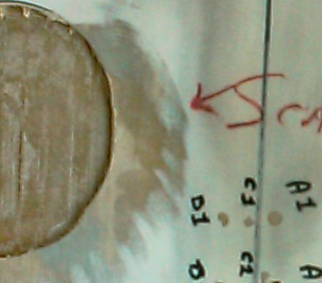
Composite Fibre NDT (2)
Scarf cut-out
The vertical ribs have been cut away leaving only the horizontal ribs in the area of the cut-out
Photograph from outside
THz image from inside

Slide 33
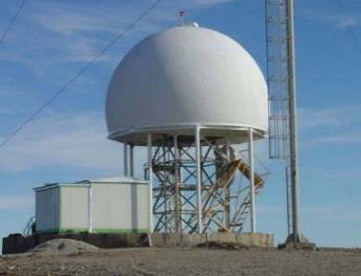
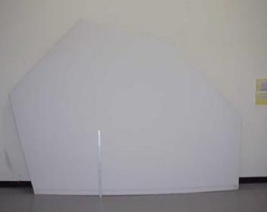
Composite Fibre NDT (3)
Radome Delamination & Water Intrusion
Weather Radome
Esscolam Sandwich Radome Panel
Water intrusion into composite laminate panel degrades radar performance. It is also very detectable with Terahertz

Slide 34
Composite Fibre NDT (4)
Bonded Seam Inspection on roof waterproofing

Slide 35
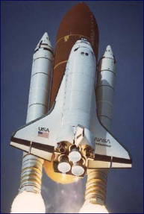
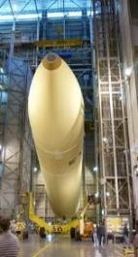
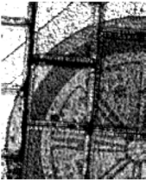
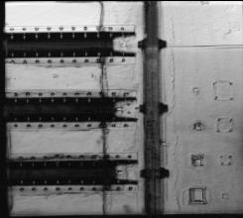
NASA Quality Control
Historic:
External fuel tank foam (SOFI)
Imaging through thermal tiles of Orbiter
Recent:
Imaging of heat shield of Orion capsule

Slide 36
Terahertz for coating measurement
Terahertz technology provides a fast (potentially several hundred readings per second) method of measuring the thickness of non-conductive coatings over a wide range of substrates.
Can typically measure to an accuracy of a few microns or better.
Non-contact – sensor head can be 100mm or more from the surface (as long as this distance is well controlled)
Soft or ‘wet’ coatings can be measured without problems.
Can distinguish and separately measure multilayer structures and coatings

Slide 37
THz Coating measurement: Reflection of coatings on conductive surfaces
Thin Paint on metal
Notes:
Approx 70um coating, measurable, although relatively hard to separate peaks when paint gets much thinner.

Slide 38
THz Coating measurement: Reflection of coatings on conductive surfaces
Thick (≈1mm)
coating on metal
Notes:
Note much stronger reflection from metal, and ‘repeat echo’

Slide 39
THz Coating measurement: Reflection of coatings on conductive surfaces
Ceramic on metal
Notes:
High dielectric constant – much stronger reflection at surface.

Slide 40
THz Coating measurement: Reflection of coatings on conductive surfaces
Paint on Carbon composite

Slide 41
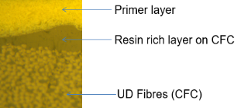
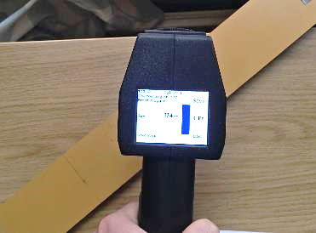
Application Case study - Epoxy coating on carbon composite
Client supplied sample with multiple different thicknesses of paint over carbon composite. The composite has a significant (around 50μm) resin layer over the carbon
Nominal thickness readings were available, although there was some variation within the different areas.
Used Terametrix TCU with single point gauge
Notes:
Because the resin layer was relatively thin, it was not possible to separate this from the paint layer – what we measure is essentially the sum of both. If the paint and resin layers were both thicker it should be possible to separate them.

Slide 42
Application study - Epoxy coating on carbon composite
Methodology
Make initial measurements using nominal (from auto calibration ‘wizard’) values for dielectric content.
5 readings per step in ‘X’ pattern, calculate mean value.
Compare to supplied measurement values.
Optimise dielectric constant value for ‘best match’
Repeat measurements and compare.
Then carry out field measurements using the derived set up

Slide 43
Application study - Epoxy coating on carbon composite
Step A Thin area.
Mean value from THz Measurement 74 μm
Client estimated value resin plus coating 69 μm

Slide 44
Application study - Epoxy coating on carbon composite
Step C Medium area.
Mean value from THz Measurement 176 μm
Client estimated value resin plus coating 159 μm

Slide 45
Application study - Epoxy coating on carbon composite
Step D Medium-high area.
Mean value from THz Measurement 261 μm
Client estimated value resin plus coating 224 μm

Slide 46
Application study - Epoxy coating on carbon composite
Step F Thicker area.
Mean value from THz Measurement 330 μm
Client estimated value resin plus coating 289 μm

Slide 47
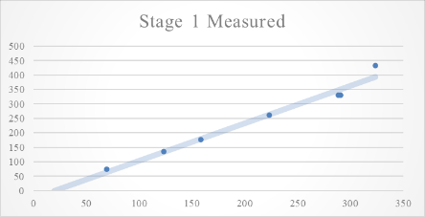
Application study - Epoxy coating on carbon composite
Graph showed reasonable correlation between measured and supplied values
Adjusted dielectric constant value and offset to give match at step D (approx. 225 μm)

Slide 48
Application study - Epoxy coating on carbon composite

Slide 49
Field trials - Epoxy coating on carbon composite
[Details confidential ]
Measured values at 9 points each on approximately 30 test panels
Then measured at multiple points on actual components.
Client then analysed results. Good feedback

Slide 50
Conclusions from this case study
There was a good correlation between TeraHertz and client supplied readings.
>100 readings per second possible using Terahertz System.
Client carrying out production trials
Method is applicable to coatings on metal, Fibre reinforced composites or plastics with minimal change in settings

Slide 51
A note on Companies:
The TeraHertz equipment is manufactured in the USA by Terametrix, a division of Luna Industries, Ann Arbor, MI
Baugh & Weedon is the Worldwide distributor for NDT and related markets. In the USA this is handled via our associate Alban NDE
My company, Level X NDT, provides additional technical and marketing assistance.

